Slide 1
OBL Microteaching activity
PGCert in Academic Practice
Sonia Vega-Pérez

Slide 2
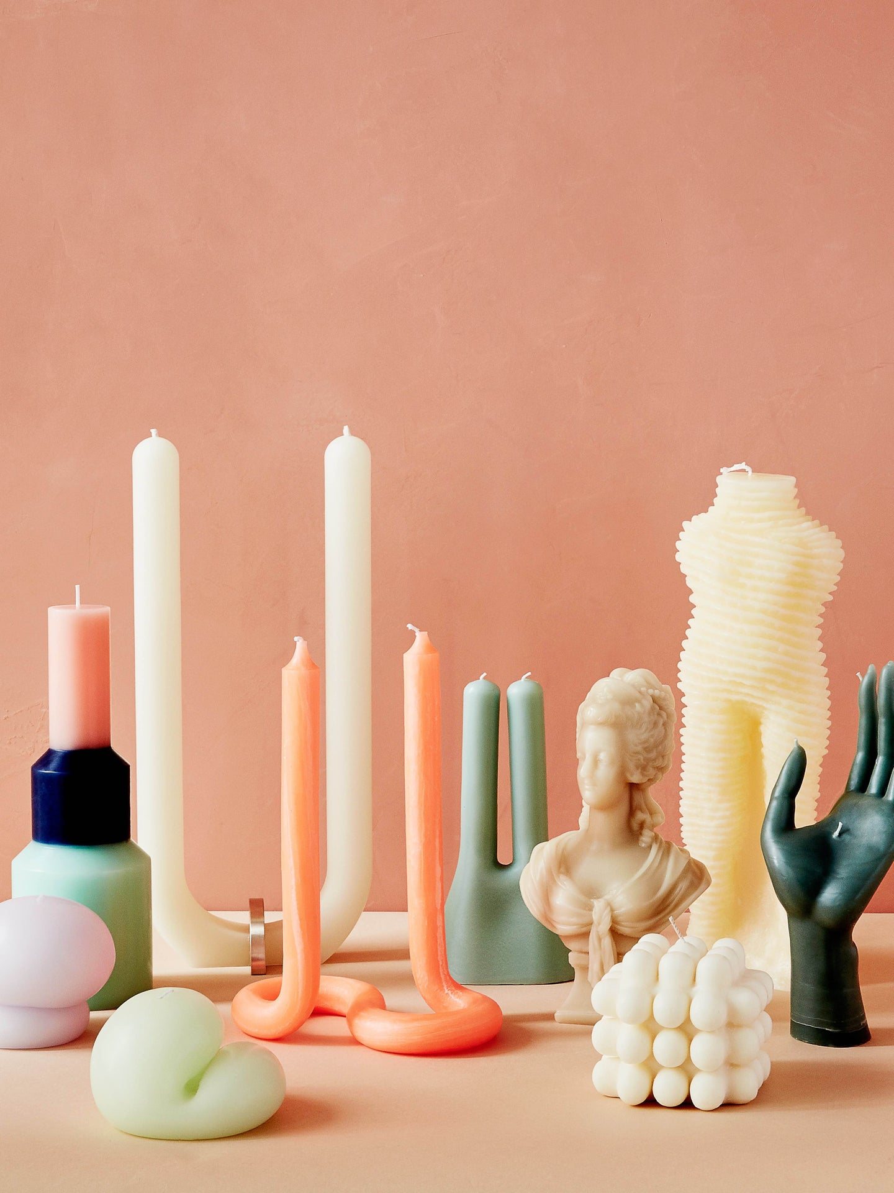
Context of session & intended outcomes
The object
Disseminating and interpreting the object together
Recreating the object

Slide 3
Context of session and intended outcomes
Theoretical & practical context
Intended outcomes
Trend research: Analysis & forecasting:
Consumer culture
Cultural movements
Material culture
Conceptual mapping for:
Contextualisation of the item
Decode main characteristics
Interpretation of value - A Matter of taste (Hardie, 2015)

Slide 4
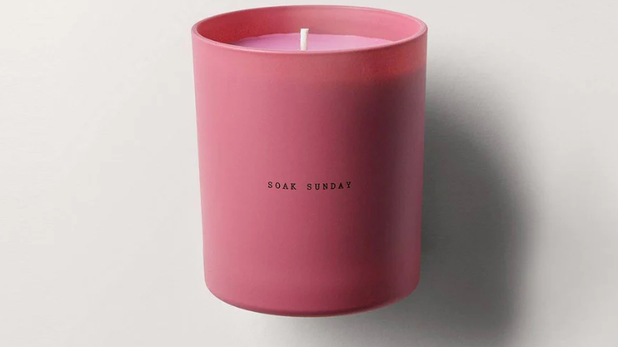
The object: Candle

Slide 5
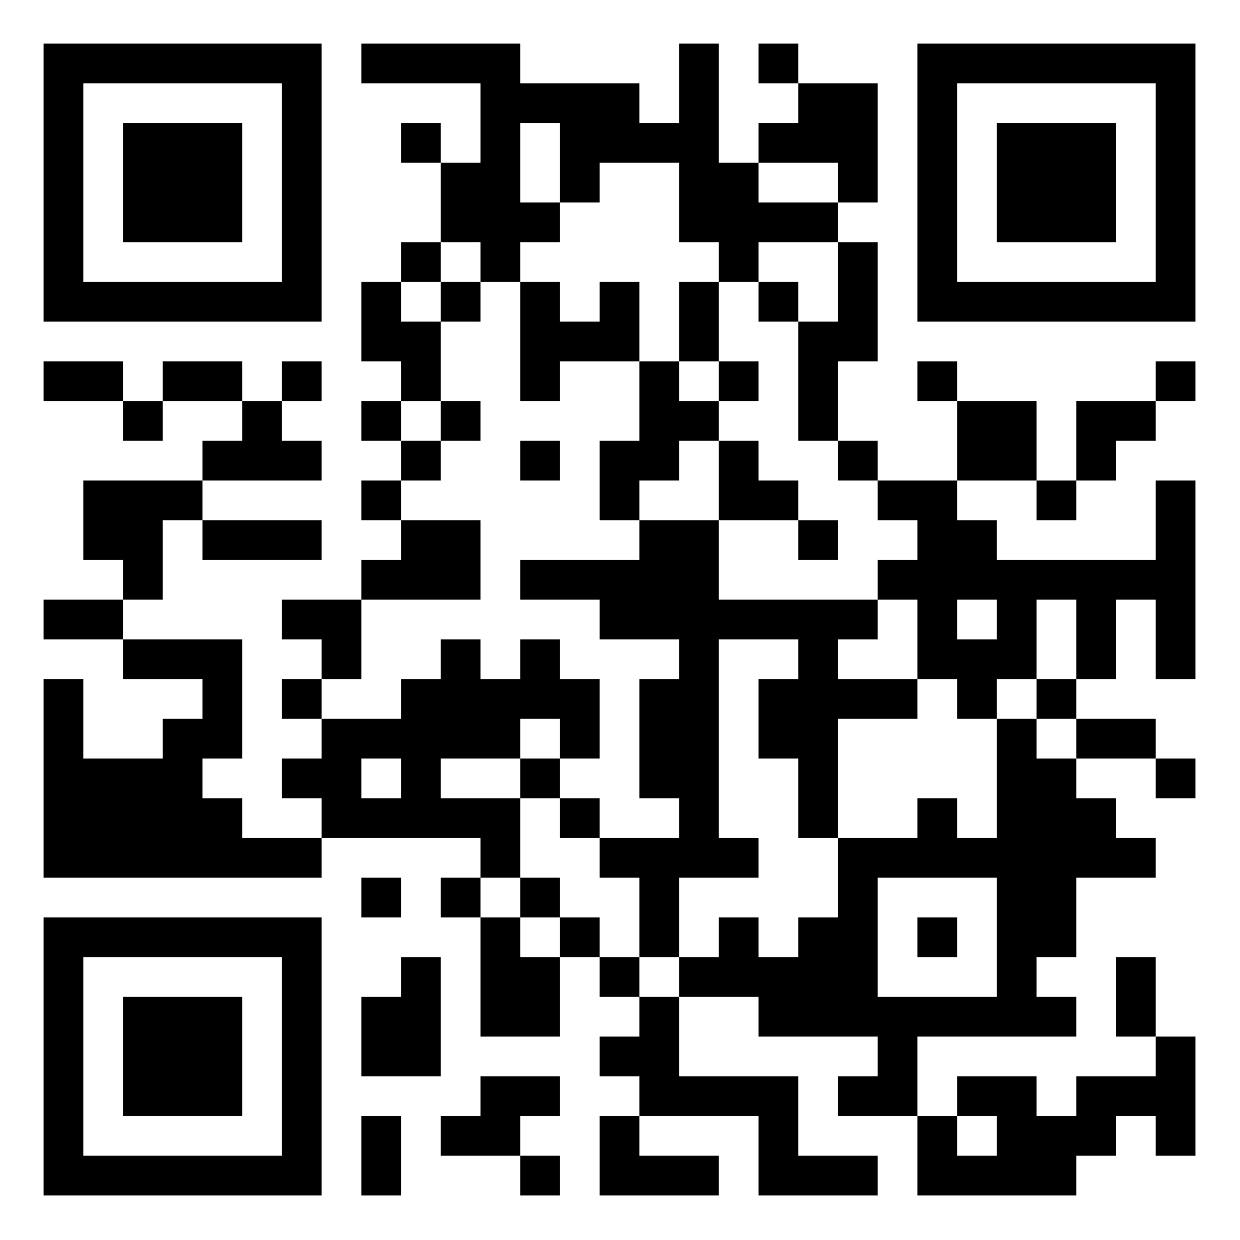
The object: Candle
Find a candle you like –online or around your place- and post an image of it on the board using the QR code.
Padlet board

Slide 6
The object: Candle
In a separate post, drop a few adjectives to describe it: colour, shape, scent, packaging, materials, origin,..
Padlet board

Slide 7
IN ONE word...
(...or image!)
What is the first thing that you think of when you think of a candle?
Padlet board

Slide 8
USES & CONTEXT
How does it work? Does it need other objects to function?
WHEN are they used? Any situations, occasions for candles.
WHERE do you locate candles? Where do you find them, where do you go to buy them? What other items do you find/buy along candles?
Padlet board

Slide 9
Object Range variety
What is the most defining feature in a candle? Is it the lasting, the smell, the aesthetic, the packaging,...?
Can you think of any types, scents, materials...in particular?
Padlet board

Slide 10
Make IT PERSONAL...
What influence your candle choices?
What would you change from your candle?
Write, draw or create an image using the AI function in a new post
Padlet board

Slide 11
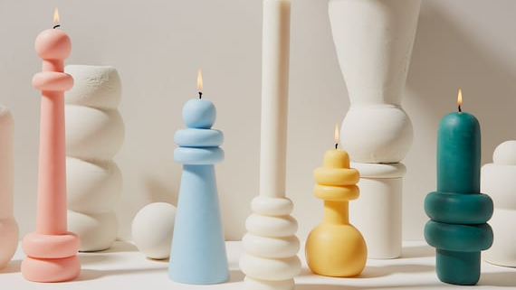
Thank you!

Slide 12
References
Hardie, K. (n.d.). Innovative pedagogies series: Wow: The power of objects in object-based learning and teaching. [online] Available at: https://s3.eu-west-2.amazonaws.com/assets.creode.advancehe-document-manager/documents/hea/private/kirsten_hardie_final_1568037367.pdf.

